Slide 1
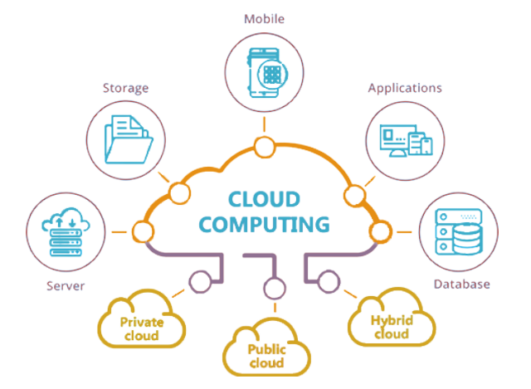
Cloud Solution Architect
Module 1
Lecture 1
Course Orientation
Introduction to Cloud Computing

Slide 2
Syed Imran Hussain
Trainer's Profile
  Senior DevOps Manager at OpenWare Business Pvt Ltd
  IT Enthusiast / Top Rated Freelancer / Consultant / Entrepreneur
  Member Open Source Foundation of Pakistan

Slide 3
Course Outline
Hours of Study
Session | Hours Per Week
Theory | 2
Lab | 3
Office hours | 1
Practice and Self Learning | 3

Slide 4
Course Outline
Labs and Exams
  Practical Tasks in Each Lab
  Assignments for Every Topic
  Mid Term Exam after 8 weeks
  Final Exam after 16 weeks
  Project at the completion of the course

Slide 5




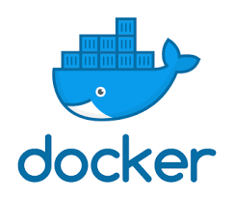

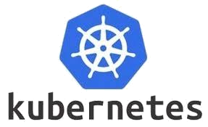
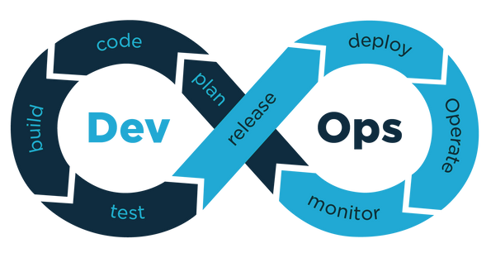
Course Outline
Tools and Technologies

Slide 6
Course Outline
Course Learning Outcomes
On Successful Completion of this course, the student shall be able to:
  Attempt AWS Cloud Practitioner Certification
  Deploy and manage cloud infrastructure and resources
  Contribute to the global workforce for cloud-based application deployment
  Create and convert legacy software to containerization

Slide 7
Course Outline
Prerequisite
  Basics of IP addresses
  Basics of Computer Networks
  Basics of Computer Programming
  Feel free to ask relevant questions whenever in doubt

Slide 8



Course Outline
Video References
  opensourceeducation.net
  Youtube Channel: WBITT
  Youtube Channel: Babar Zahoor

Slide 9
BE BRAVE ENOUGH
TO BE BAD AT
SOMETHING NEW

Slide 10
Learning Objectives
Module 1 - Lecture 1
  Introduction to Cloud Computing
  IaaS, PaaS, SaaS, On-Prem

Slide 11

Why Cloud Computing?

Slide 12
Scope of Cloud Computing
  In demand high-end jobs like software architect and DevOps Engineer require cloud skills
  https://www.bmc.com/blogs/cloud-growth-trends/
  Indeed.com, identified the "booming" cloud skills as a major trend in the tech skills market.

Slide 13
Cloud Computing in Pakistan
  booming industry in Pakistan
  Government organizations' impressive results in cloud
    HEC, PITB, and NTC
  Private companies providing cloud services
    RapidCompute, PTCL, Nayatel

Slide 14
What is Cloud Computing?
  On-demand availability of computer system resources, especially computing power and storage
  automation of virtualization
  Storing and accessing data and programs over the internet
Notes:
Cloud computing transforms IT infrastructure into a utility:
It lets you ‘plug into' infrastructure via the internet,
and use computing resources without installing and maintaining them on-premises.

Slide 15
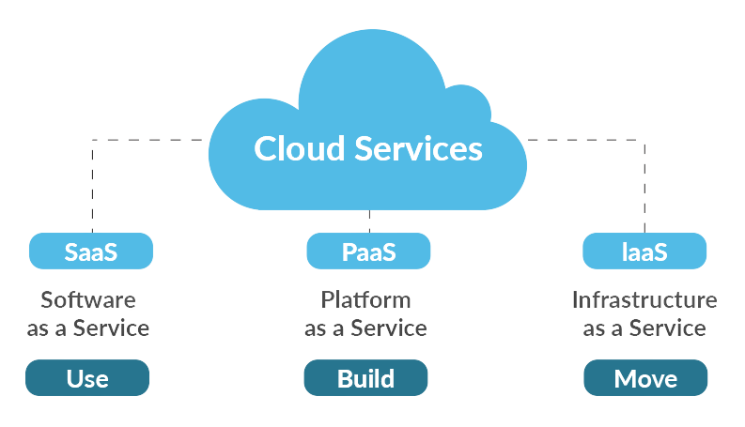
Service Models of Cloud Computing

Slide 16
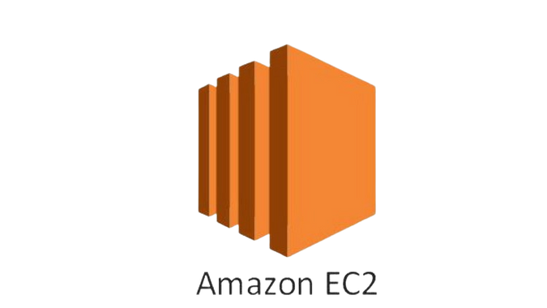
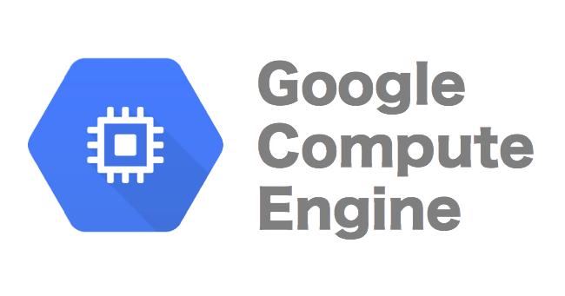



Infrastructure as a Service (IaaS)
Computing Resources over internet

Slide 17
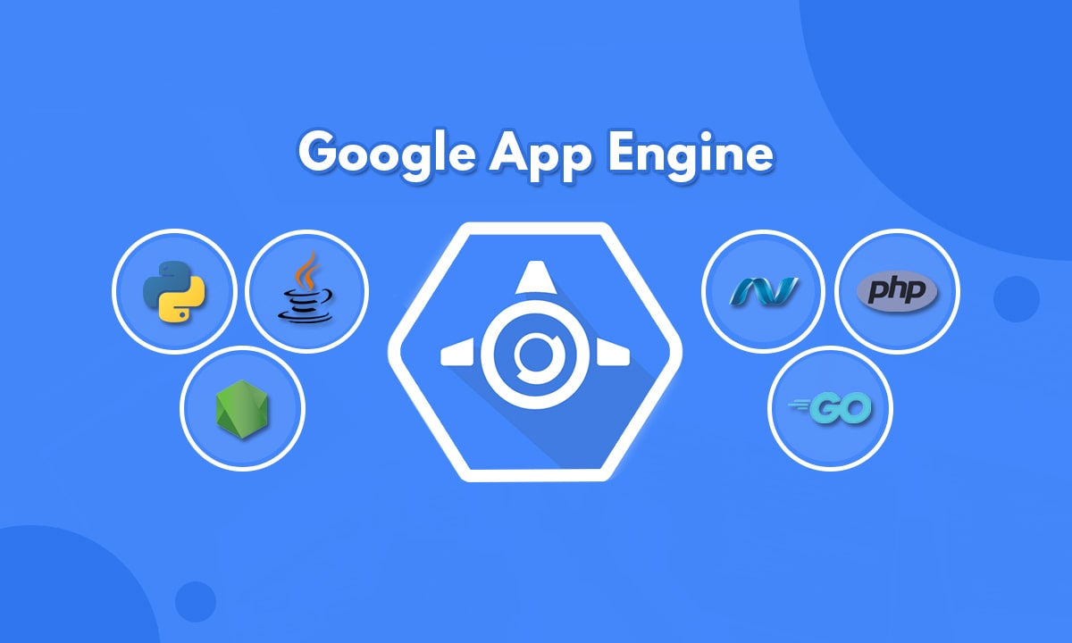

Platform as a Service (PaaS)
Tools over internet, usually for application development

Slide 18




Software as a Service (SaaS)
Software Distribution Model

Slide 19


On-Prem Private Cloud
On-Site Cloud Infrastructure

Slide 20
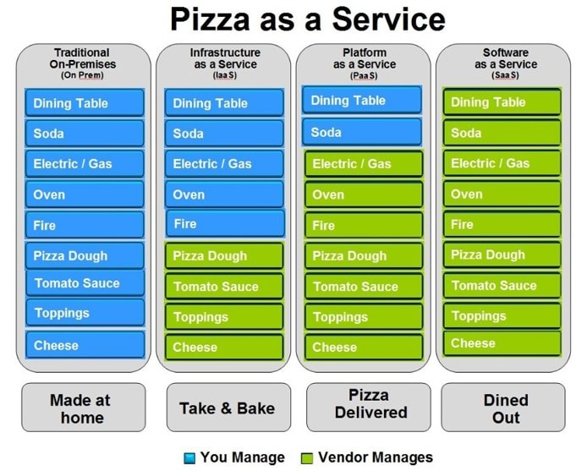

Slide 21
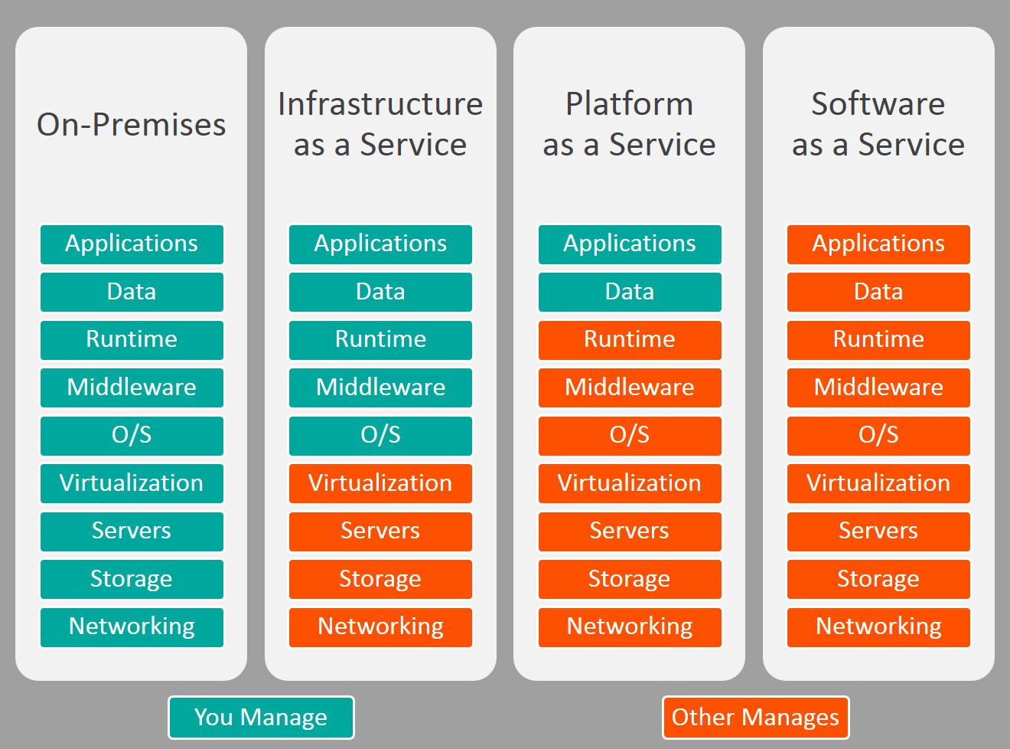

Slide 22
Summary
Module 1 - Lecture 1
  Introduction to Cloud Computing
  IaaS, PaaS, SaaS, On-Prem

Slide 23
Next Lecture
Module 2 - Lecture 2
  Introduction to Linux
  Introduction to Virtualization

Slide 24

Ask Questions!!

